Slide 1
Money Manager Personal Expense Tracking System
Project by [PRIYADHARSHINI N]

Slide 2
AGENDA
Abstract
Existing System
Proposed System
Advantages
Disadvantages
Hardware Requirements
Software Requirements
Modules
Module Description
Sample Output(Screenshot)
Conclusion

Slide 3
Abstract
The Money Manager is a web-based application designed to help users manage income, track expenses, and analyze spending patterns effectively.
It allows users to add transactions, categorize expenses, visualize data through charts, and receive personalized financial tips.
The system aims to improve personal finance management by offering a simple, interactive, and visually appealing interface.

Slide 4
Existing System
Manual record-keeping or spreadsheets are error-prone.
No real-time visualization of spending habits.
No personalized advice or automatic tracking.
Data often gets lost or disorganized.
No budget planning or remainders.
No data backup or recovery option.

Slide 5
Proposed System
Digital expense tracker that stores and visualizes income and expenses.
Built with HTML, CSS (Tailwind), and JavaScript
Uses browser localStorage for offline data saving.
Provides personalized expense tips and monthly reset.
Interactive chart-based expense analysis.

Slide 6
Advantages
User-friendly and responsive interface.
Works offline using local storage.
Visual charts for easy understanding.
Personalized tips for better budgeting.
Easy edit/delete transactions.
Automatic monthly reset.

Slide 7
Disadvantages
Data stored locally (can be lost if browser data is cleared).
No multi-user or online login support.
Limited to basic analytics.
Time consuming to update daily.
Data privacy and security issues.
Risk of data loss if app crashes.

Slide 8
Hardware Requirements
Processor: Dual Core or higher
RAM: 2 GB minimum
Storage: 100 MB free space
Display: 1024×768 or higher
OS: Windows / macOS / Linux

Slide 9
Software Requirements
Frontend: HTML5, CSS3 (Tailwind), JavaScript
Backend: Local Storage (Browser)
IDE: VS Code / Sublime Text
Browser: Chrome / Edge / Firefox

Slide 10
Modules
Income Module
Expense Module
Category Module
Visualization Module
Tips Module
Monthly Reset Module

Slide 11
Module Description
Income Module: Add total income for the month.
Expense Module: Add, edit, and delete expenses.
Category Module: Create custom categories.
Visualization Module: Display expense charts.
Tips Module: Suggest ways to save money.
Monthly Reset Module: Clears old data monthly.

Slide 12
Sample Output
Dashboard showing income, expenses, and balance.
Expense category chart visualization.
Transaction history with timestamps.

Slide 13
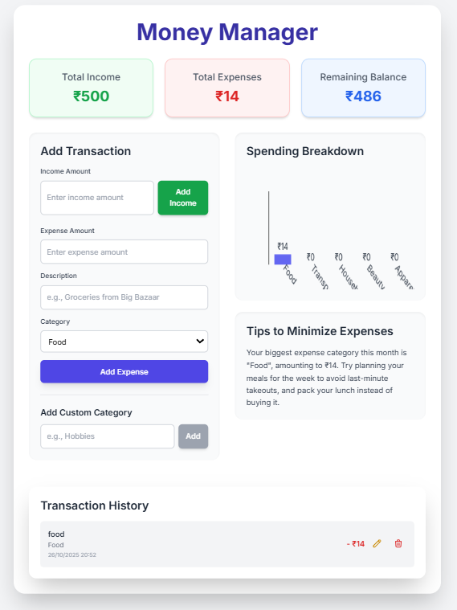
Sample Output (Screenshot)

Slide 14
Conclusion
The Money Manager provides a simple yet powerful solution for personal finance management.
It enhances financial awareness and promotes budget discipline.
Future scope includes cloud data sync, user accounts, and AI-driven savings insights.

